Slide 1

Group members
CSE 021 introduction to computer programming
Instructor: Dr. Basma Hassan
TAs : Eng. Aya Abdelnaby & Eng. Karim Sewilam
Abdullah Ayman 21-101131
Asem Ebrahim 21-101159
Amar Wael 21-101152
Youssef Nagah 21-101139

Slide 2

Main Points
How did we start and why we chose this program (chatbot for a telecommunication company)
Sites we got information from
Information we got from these sites
A quick look at the project

Slide 3

How did we start this project
Brainstorming session
Searching online
Trying to chat with some chatbots of well-known companies
Getting into the code !

Slide 4

Why did we pick this program
It was a new challenge for us.
We saw that it will improve our C.
We were interested more in coding a chatbot.
All companies use now chatbots especially telecommunication companies.
This Photo by Unknown author is licensed under CC BY.

Slide 5

Sites we got information from (References)
https://jasoren.com/chatbot-for-telecom-company/
https://stackoverflow.com/
https://www.geeksforgeeks.org/

Slide 6

Information we got from these sites
What a chatbot of a telecommunication company is intended to do
Solution of some errors
Libraries making the code simpler and less e.g.(string.h)
Syntax of some new concepts e.g.(two dimensional arrays)

Slide 7
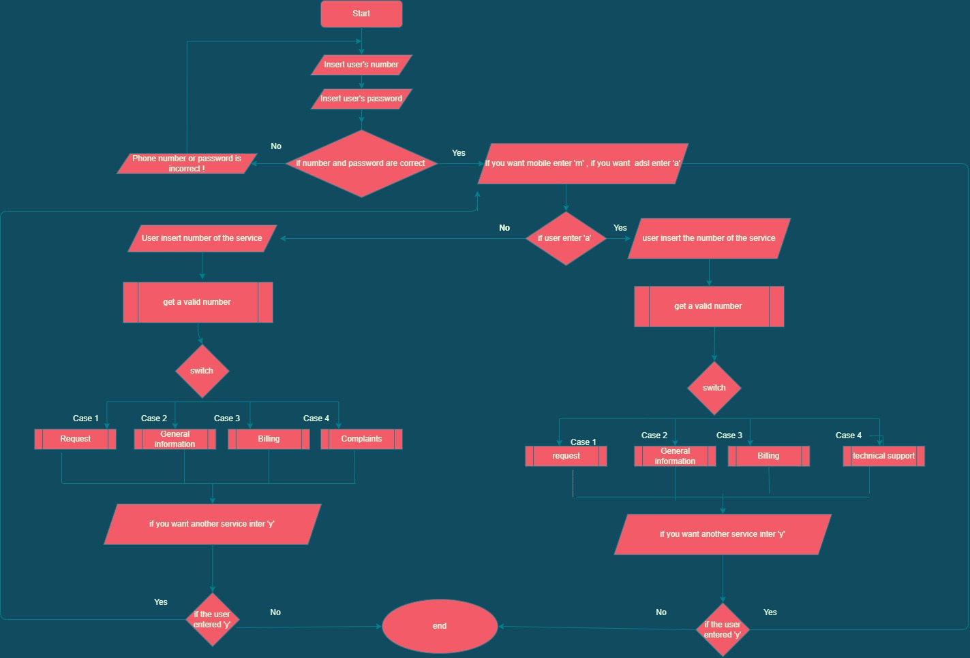
Flow chart of the program

Slide 8

Authentication (Login)

Slide 9
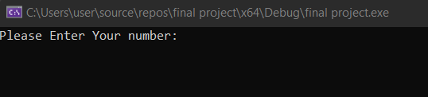
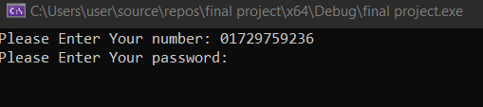
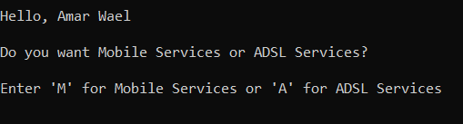
1. Prompt the user to enter his number.
2. Prompt the user to enter his password.
3. Asking the user if he want mobile or ADSL services.

Slide 10

Mobile Services tracing

Slide 11
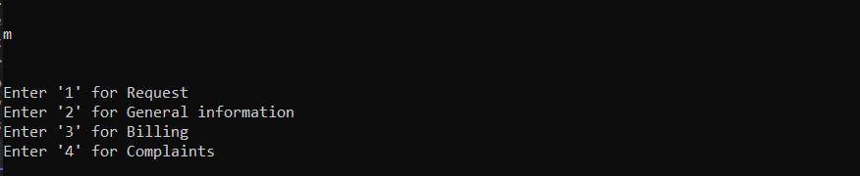
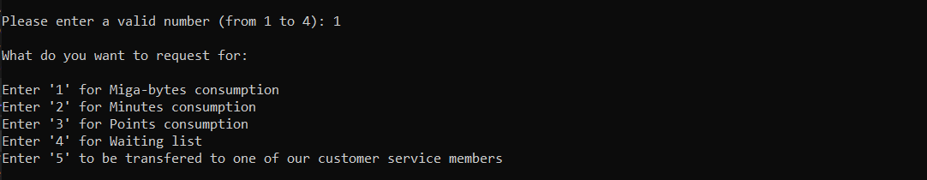
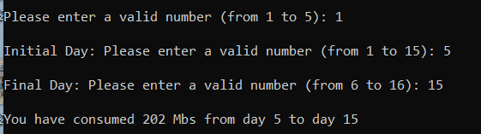
If the user choose 'M' this screen will appear.
If the user choose'1' Request options appears
If you choose '1' he will ask you about initial and final day and give you your megabytes consumption

Slide 12
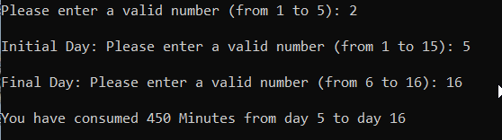
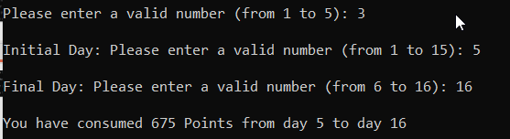
If you choose '2' he will ask you about initial and final day and give you your minutes consumption.
If you choose '3' he will ask you about initial and final day and give you your points consumption.

Slide 13
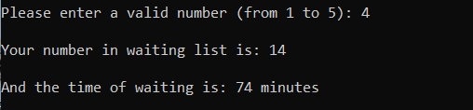
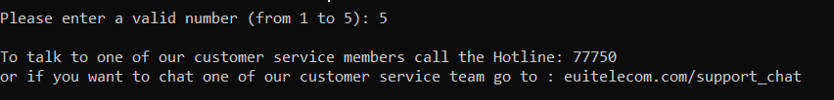
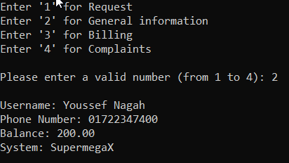
If you choose '4' he will give you your number in waiting list and time of waiting.
If you choose '5' he will give you customer service contacts
Back to main mobile options , If you choose '2' he will give you all your info.

Slide 14
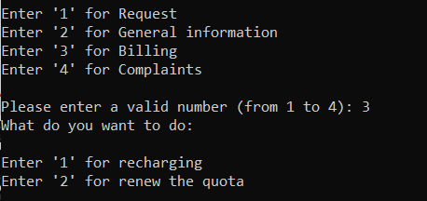
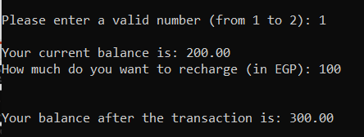
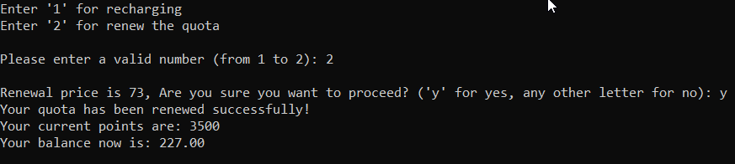
If you choose '3',he will ask you to choose recharging or billing.
If you choose '1',he will ask you about amount of transaction then add it to your balance
If you choose '2', he will renew your quota if you have enough balance.

Slide 15
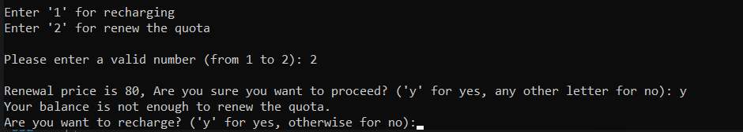
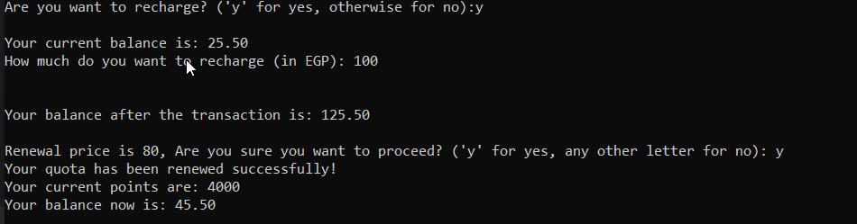
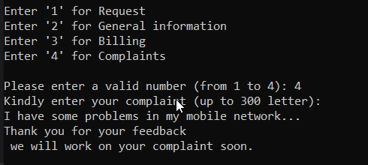
If you don't have enough money, he will ask you if you want to recharge.
If you recharge your balance, he will ask you if you want to renew your quota and renew it.
Back to main mobile options , If you choose '4' he will let you to write your complaint.

Slide 16
ADSL Services tracing

Slide 17

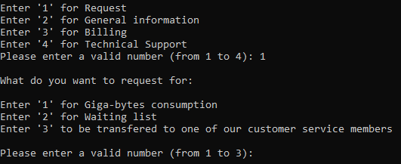

Asking you which service do you want
When you choose Request, the chatbot asks you what do you want to request for
From which day do you want to know you consumption

Slide 18


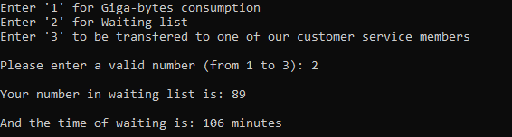
And to which day ?
It sums you consumption through this period and gives you the total consumption
When you choose Waiting list in (requests) the chatbot gives you your number and an estimated waiting time

Slide 19
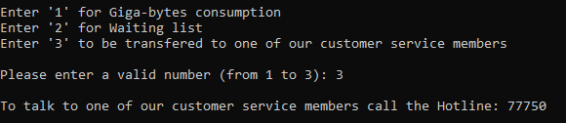
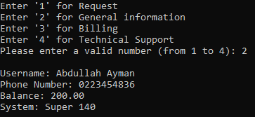
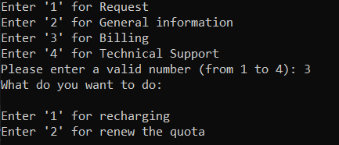
When you choose customer service (3), it gives you our hotline
When you choose General information from (Services), you get all your information
If you choose '3',he will ask you to choose recharging or billing.

Slide 20
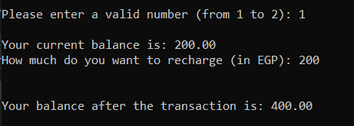
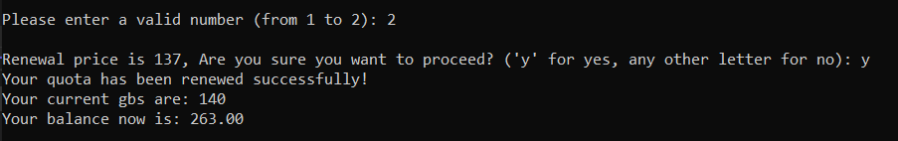
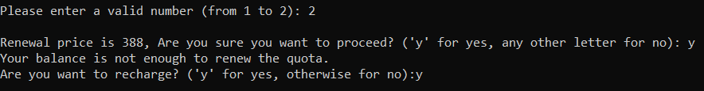
If you choose '1',he will ask you about amount of transaction then add it to your balance.
If you choose '2', he will renew your quota if you have enough balance.
If you don't have enough money, he will ask you if you want to recharge.

Slide 21
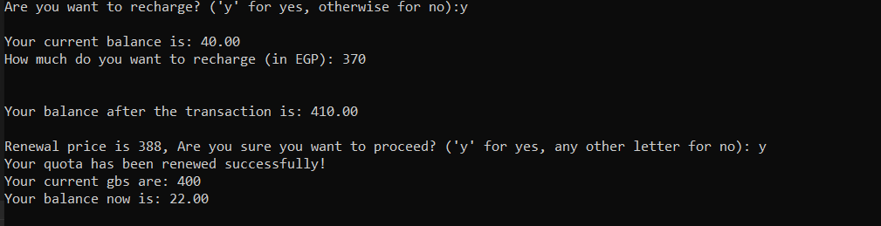
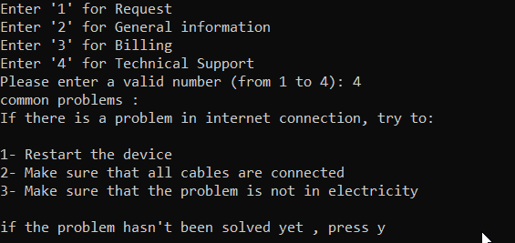
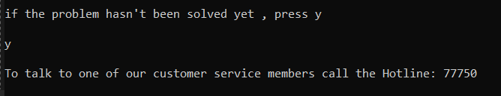
If you recharge your balance, he will ask you if you want to renew your quota and renew it.
Back to ADSL main options, If you choose '4', he will give you some solutions and ask you if they worked.
If not , he will give you customer service contacts

Slide 22
General Services tracing

Slide 23
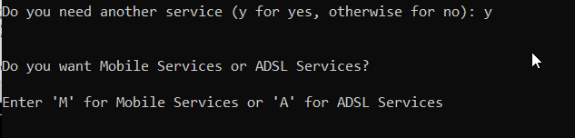
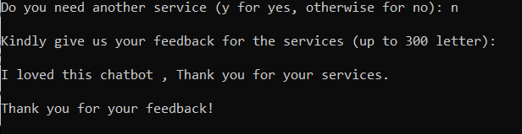
After finishing your service, he will ask you if you want any other services, If yes, he will repeat the program.
If no, he will ask you about your feedback and let you insert it then closing the program.

Slide 24
Thank you for listening

